Slide 1
ASP.NET SignalR
Quantum Entanglement web applications with .NET

Slide 2
Chris Berthold
Over 15 years of development experience developing quality software and network administration
10 years of business development in a manufacturing setting
6 years of development as software consultant
Private pilot
Currently works on the awesome Product Development Team for Flightdocs

Slide 3
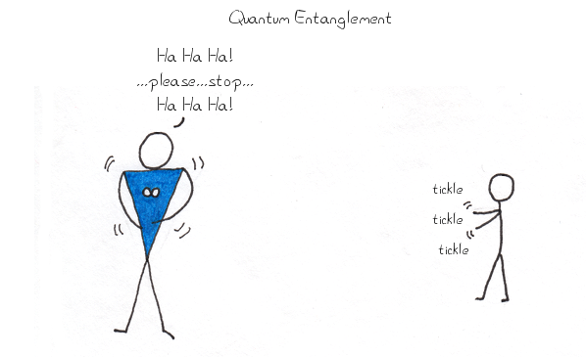
Quantum Entanglement… what?
In physics, two particles can act together in order to behave as one system so that a change made to one particle instantly affects the other – even if they are separated by great distances.

Slide 4

Albert Einstein
“spooky action at a distance”
The closest analogy to this for web development is to observe a change to webpage as a result of entering data in another web page – The real-time web
Examples:
Google Analytics
Google Docs
Office 365 Web
Silly chat applications (we wont do one of those)
Stock Ticker (nope… not this one either)

Slide 5
Previous Real-Time Technologies
AJAX Polling
Starts up potentially lengthy thread
Polls at a known interval waiting for a response or to check on progress
Is only near real-time and doesn’t provide the constant and continuous connection
Long Polling
Request that blocks I/O on server waiting for a response to send to client
Requires lots of multi-threaded knowledge
Performs poorly as the number of threads increases
Easier now with Task Parallel Library but still requires developing server and client libraries

Slide 6

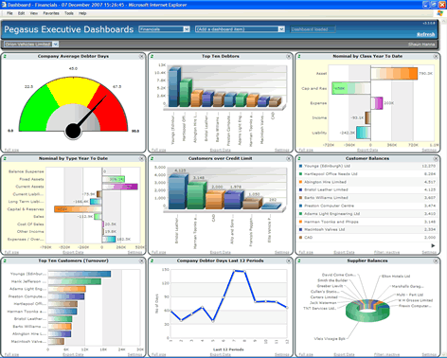
Business Scenario and Web Demo
You have a Line of Business application designed in AngularJS and ASP.NET. Your manager wants his dashboard updated in real-time.
You’ve decided on SignalR to help with the integration

Slide 7
What does SignalR do for me?
Allows server-side code to push content to clients in real-time
Allows bi-directional communication between server and client
WebSockets #1
Handles graceful fallback (Event Source, Forever Frame, Ajax Long Polling)
Out of box API for handling:
Client RPC (calling client javascript functions)
Connect/disconnect events
Connection grouping
Authorization
Cross-platform client libraries (.NET, Javascript, Mono, iOS, Java)
Easy to scale

Slide 8
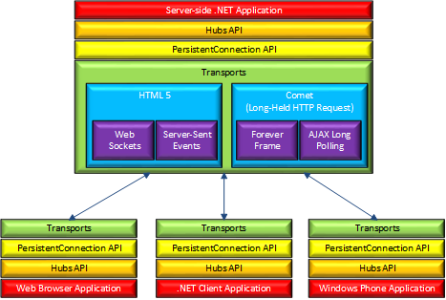
Architecture
We’ll be sticking here

Slide 9

Getting Dirty with SignalR – Code and Demo
Simple example using KnockoutJS and SignalR

Slide 10
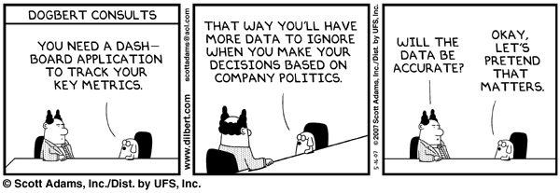
Wrapping Up – AngularJS and SignalR
Wiring up our Line of Business Dashboard application to be real-time
Almost time for beer

Slide 11
Scaling SignalR – What are my options?
SignalR has many great options for scaling using backplane
Azure Service Bus – (both on-premise and cloud)
Windows Service Bus – (similar implementation on-premise only)
SQL Server – (Uses SQL Broker or polling)
RabbitMQ
Redis
NServiceBus
MassTransit
Implement your own using IMessageBus interface
Consider a single message bus for all of your related applications

Slide 12
Performance Considerations
Try to use smallest datasizes and serialize using smaller fields with JsonProperty
This improves client performance as well
You can use a field mapper on client if naming is important
By default 1000 messages are buffered per hub – server memory may be a concern
Make sure not to have too many hubs
Make sure your messages stay tight
Adjust with GlobalHost.Configuration.DefaultMessageBufferSize = 500;
SignalR has performance counters built in

Slide 13
Debugging
Client Side Debugging Available
Javascript: $.connection.hub.logging = true; $.connection.hub.start();
.NET: var hubConnection = new HubConnection("http://www.contoso.com/"); hubConnection.TraceLevel = TraceLevels.All; hubConnection.TraceWriter = Console.Out;
Enabled detailed errors on server – Setup.cs
var hubConfiguration = new HubConfiguration(); hubConfiguration.EnableDetailedErrors = true; App.MapSignalR(hubConfiguration);

Slide 14
Thanks for listening – Lets Get Beer
Great information and reading material athttp://www.asp.net/signalr/overview
Tutorials
Examples
Stuff I didn’t get to
SignalR source and repo at http://github.com/SignalR
More examples for all kinds of platforms
Stock Ticker, Chat, Game Example

